Slide 1

AAA BLOCKCHAIN GAME STUDIO
Rohail Asghar 19L-0974
Zaeem Yousaf 19L-1196

Slide 2

Vision Statement
Provide video game players a chance to make some income through GameFI
Innovate Blockchain and Web3 technology in Pakistan

Slide 3

What is GameFI
GameFi is the combination of games with financial incentives for players. It creates maximum value for players instead of extracting value from them.

Slide 4
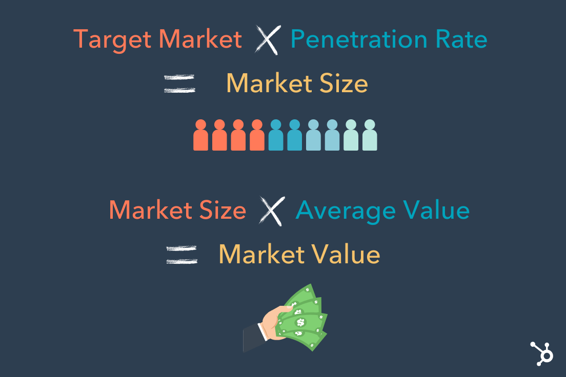
Market Size & Target Customers
Game industry is a multi billion dollar market with statistics claiming it to be around $200 billion.
Blockchain industry is evolving with the world moving towards Web3
GameFI targets casual gamers as well as crypto investors and enthusiasts

Slide 5
Revenue Streams
Selling copies of video games
Typically AAA titles sold for $5-$20
Selling crypto assets as NFTs
Value is defined by supply and demand in the market
Crypto tokens
Creator fees per transaction on NFT markets such as Opensea.io or Rarrible

Slide 6
Economic & cash Flow
Year | 2022 | 2023 | 2024 | 2025 | 2026
Total Cash Inflow | $0.77 million | $2.38 million | $10.68 million | $23.22 million | $32.4 million
Total Cash Outflow | ($0.785 million) | ($1.106 million) | ($3.76 million) | ($6.595 million) | ($8.42 million)
Total Profit | ($15,000) | $1.247 million | $6.92 million | $16.625 million | $29.98 million

Slide 7
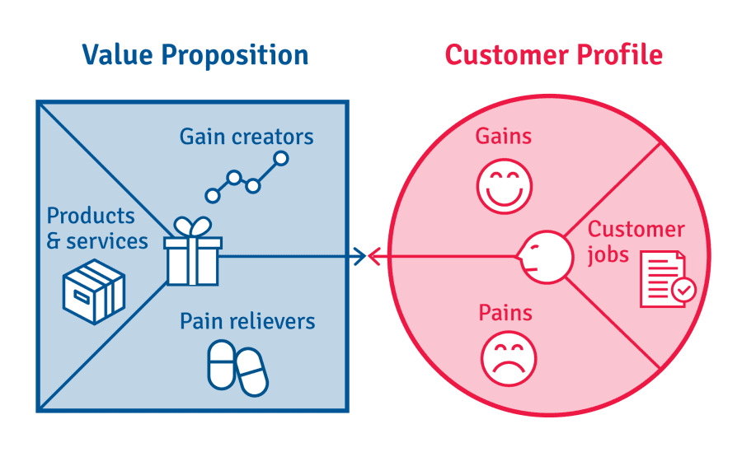
Value Proposition
Allow video game players to earn some rewards for their participation in the game.
Giving real world value to digital assets
Give players true ownership of their digital assets
Allow players to trade their digital assets freely through decentralization

Slide 8
Marketing & Expansion Plan
Get crypto influencers behind the projects
Get Esports influencers and celebrities on board as brand ambassadors
Run ad campaigns through social media platforms.
Expand gradually starting with small story based games with rich visuals, immersive gameplay, strong decentralized economy. Eventually move towards Massive Multiplayer onlines once the team grows big enough with highly skilled professionals.

Slide 9
Damage Control Plan
Build strong relations with the community
Involve the community in the development through their feedback
Build strategies to stop devaluation of games crypto assets

Slide 10
Funding Sources
Venture Capitalists
Lots of venture capitalists looking to invest in Web3.0 based startups following the massive hype around this technology
Loans
Startups can get loans for interest rates around 10% to 28%
Crowdfunding
Create following behind the projects and let the players help fund the project

Slide 11
Team Structure
CEO, CTO, Business Developer
Project Manager
Technical Artist
Game Designers
3D artists
Game Developers
UI/UX artists
Blockchain Developers
Marketing team
QA engineers
Admin & HR

Slide 12
Milestones
Following are the major milestones related to this project
▪ Creating of the Game design document and Story Boarding
▪ Gain funding through venture capitalists
▪ Creation of core game prototype and getting feedback from potential players
▪ Work on the gameplay mechanics and refine them

Slide 13
Milestones
▪ Creation of crypto toke for the game
▪ Creation of crypto assets for the game
▪ Alpha tests
▪ Beta tests
▪ Launch

Slide 14
Incubation Center
Having unique Idea especially growing in future
Working on Cutting Edge Research
Targeting the real world problems
Play & earn is a quit unique and has a great potential in incubation center

